Slide 1


OPTIMIZING SPAM FILTERING WITH MACHINE LEARNING
RAJESWARI VEDACHALAM GOVT.ARTS COLLEGE
CHENGALPATTU-603001
Bachelor of Computer Application – 3 rd year
Presented by:
Govarthini S
Charmila L
Hemalatha D
Neelambigai R

Slide 2
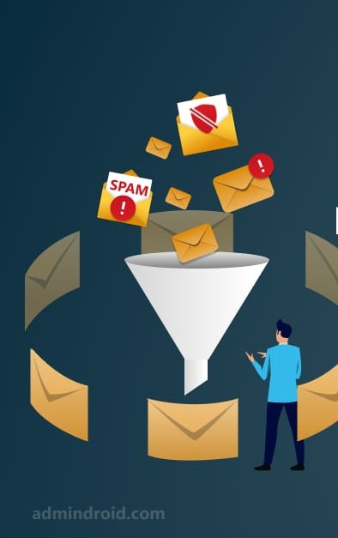
INTRODUCTION:
A spam filter is a program used to detect unsolicited, unwanted and virus-infected emails and prevent those messages from getting to a user's inbox.
different types of the spam filtering is availabe, ex: content filters, permission filters, community filters, etc.
PURPOSE:
Reduce consumes computing resources and time prevention
A good consumer perception & Global implementation
Prevention Fraud & Identify theft

Slide 3
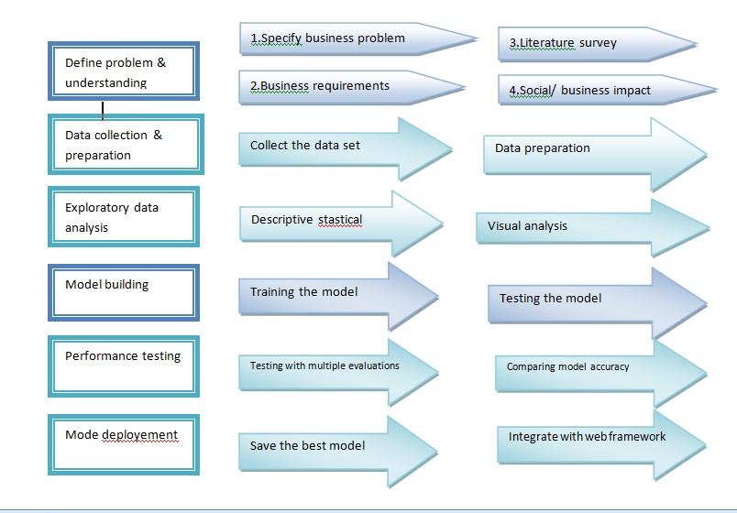
Project flow:

Slide 4
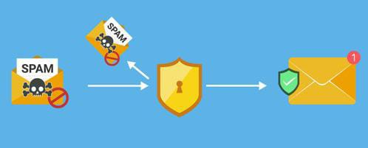
Goal of the project:
The goal of the project is to design and develop a spam detection system for emails by using machine learning.
Data collection:
The data set download from kaggle.
Importing the libraries.
Data preparation:
It need to be a restricted into clean and spam folders for training and validation purpose as a part of data preparation.

Slide 5
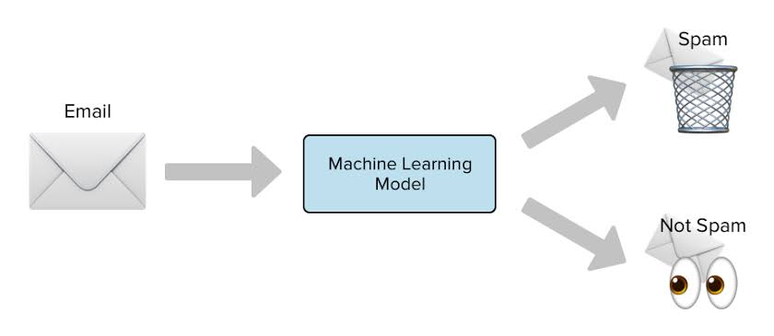
Data cleaning
Removing special charecters & numbers using regular expression
Converting the entire sms into ower case
Building a corpus for messages
Removal of stopwords
Scope of the project:
It provides sensitivity to the client and adapts wel to the future spam techniques.
It increases security and reduce it administration costs
It is also reduce netwoek resource costs

Slide 6
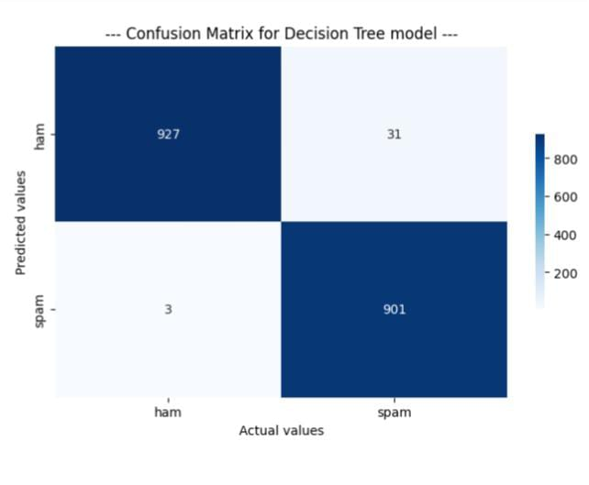
Model building
Training the model
Train the dataset with the known classes.
We using naive bayes multinomial , decision tree and Random forest.
Models for train the dataset.
Testing the model:
Use the classifier for the separating the model.
Classified file is then copied into Inbox folder if it is classified as clean or into spam folder otherwise.

Slide 7
Advantage Disadvantage
It can be trained on a per – user basis.
The spam that a user receives is often related to the online users activities.
Google by its Gmail email system, performing an OCR to every mid to large size image , analyzing the text inside.
Insertion of random innocuous words that are not normally associated with spam.
Advantages

Slide 8
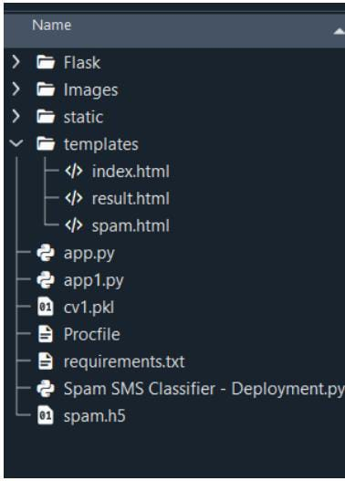
Model deployment:
Save the best model(decision tree)
Integrate with web frame work.
Build html pages.
Run the web application.

Slide 9
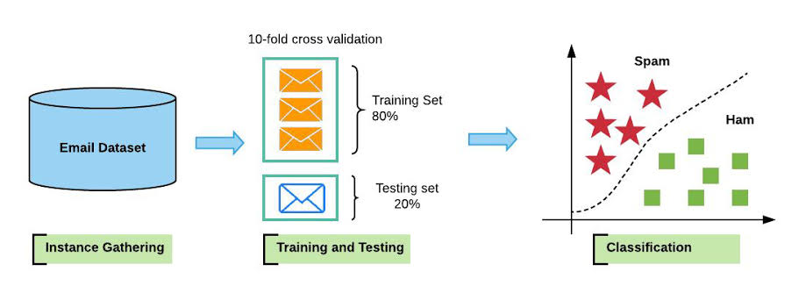
conclusion
It can be reduce trouble for service providers.
People should be mode aware about spam building.
This spam filtering can be build a reliability in the world.
Guidelines for spam detection techniques for several machine learning and deep learning techniques.
It can be protects the user from any potential cyber threat and facilities smooth communications and work flow.
unnecessary much study time is save.

Slide 10
Thank you!

